Slide 1
COMP343 - Artificial Neural Networks & Deep learning
WEEK 1
Adnan Majeed

Slide 2
Machine learning basics
Machine learning (ML) is a subset of artificial intelligence where computers find patterns in data to make predictions or decisions without being explicitly programmed.

Slide 3
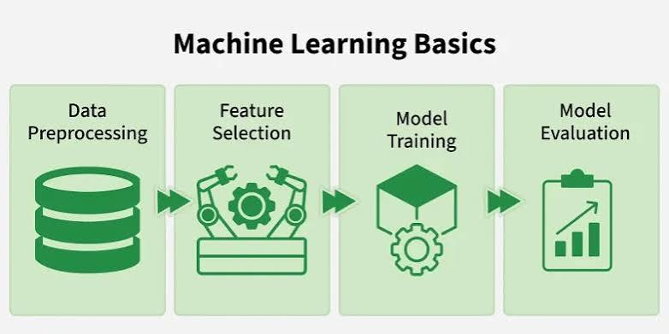
Data ?

Slide 4
Supervised Learning: The model is trained on labeled data (historical examples with clear answers). For example, a model looks at thousands of emails labeled "spam" or "inbox" to learn how to filter future emails.Classification: Predicting a category, like identifying whether an image contains a cat or a dog.
Regression: Predicting a continuous numeric value, like forecasting stock prices or housing market

Slide 5
Unsupervised Learning: The model is given unlabeled data and must discover hidden structures, groupings, or patterns entirely on its own.
  Clustering: Automatically sorting customers into separate purchasing behavior groups for target marketing. [1, 2]
Reinforcement Learning: The model learns through trial and error within an environment. It receives positive rewards for correct choices and penalties for wrong choices, which is how autonomous vehicles and gaming AI are trained

Slide 6
Introduction to Neural Networks & Deep Learning
Neural Networks are machine learning models inspired by the way the human brain processes information. They consist of interconnected layers of neurons that learn patterns from data and make predictions.

Slide 7
Neural Networks key components
Neurons: The basic units that receive inputs, each neuron is governed by a threshold and an activation function.
Connections: Links between neurons that carry information, regulated by weights and biases.
Weights and Biases: These parameters determine the strength and influence of connections.
Propagation Functions: Mechanisms that help process and transfer data across layers of neurons.
Learning Rule: The method that adjusts weights and biases over time to improve accuracy.

Slide 8
Identify Complex Patterns: Recognize intricate structures and relationships in data; adapt to dynamic and changing environments.
Learn from Data: Handle vast datasets efficiently; improve performance with experience and retraining.
Drive Key Technologies: Power natural language processing (NLP); enable self-driving vehicles; support automated decision-making systems.
Boost Efficiency: Streamline workflows and processes; enhance productivity across industries.
Backbone of AI: Serve as the core driver of artificial intelligence progress; continue shaping the future of technology and innovation.

Slide 9
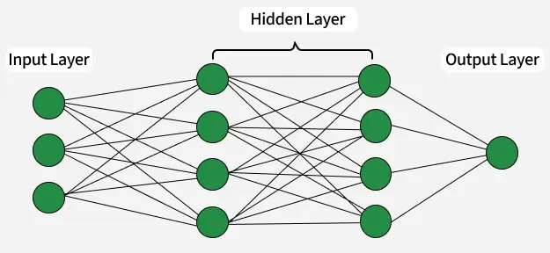

Slide 10
Input Layer: This is where the network receives its input data. Each input neuron in the layer corresponds to a feature in the input data.
Hidden Layers: These layers perform most of the computational heavy lifting. A neural network can have one or multiple hidden layers. Each layer consists of units (neurons) that transform the inputs into something that the output layer can use.
Output Layer: The final layer produces the output of the model. The format of these outputs varies depending on the specific task like classification, regression.

Slide 11
Working of Neural Networks
1. Forward Propagation
When data is input into the network, it passes through the network in the forward direction, from the input layer through the hidden layers to the output layer.

Slide 12
Backpropagation
After forward propagation, the network evaluates its performance using a loss function which measures the difference between the actual output and the predicted output. The goal of training is to minimize this loss. This is where backpropagation comes into play:
Loss Calculation: The network calculates the loss which provides a measure of error in the predictions. The loss function could vary; common choices are mean squared error for regression tasks or cross-entropy loss for classification.
Gradient Calculation: The network computes the gradients of the loss function with respect to each weight and bias in the network. This involves applying the chain rule of calculus to find out how much each part of the output error can be attributed to each weight and bias.

Slide 13


Slide 14
To classify this email, we will create a feature vector based on the analysis of keywords such as "free" "win" and "offer"
The resulting feature vector is:
free: Present (1)
win: Absent (0)
offer: Present (1)
Feature Vector:
[1, 0, 1]

Slide 15
The feature vector is passed through the neural network, where each neuron computes a weighted sum of the inputs and applies an activation function to produce its output.
Hidden Layer Calculation:
Assume the hidden layer contains two neurons with the following weights
Neuron H1: [ 0.5, −0.2, 0.3]
Neuron H2: [ 0.4, 0.1, −0.5]
For the input vector [1, 0, 1], the weighted sums are:
For H1: (1 × 0.5) +(0 ×− 0.2) + ( 1 × 0.3) = 0.5 + 0+ 0.3 = 0.8
For H2: (1 × 0.4) +(0 × 0.1) + ( 1 × −0.5) = 0.4 + 0 −0.5 =−0.1
Applying the ReLU activation function:
H1 Output: ReLU(0.8) = 0.8
H2 Output: ReLu(-0.1) = 0

Slide 16
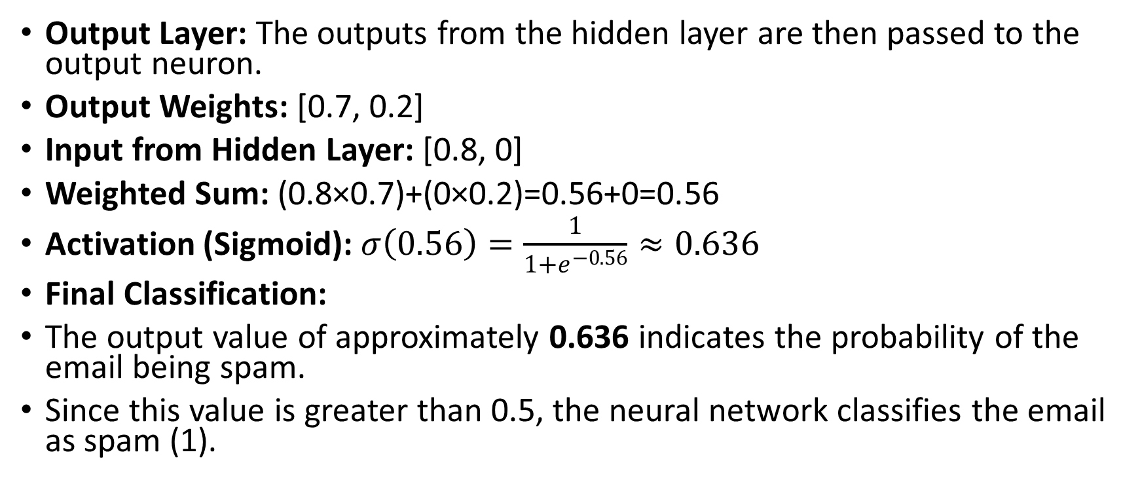
Output Layer: The outputs from the hidden layer are then passed to the output neuron.
Output Weights: [0.7, 0.2]
Input from Hidden Layer: [0.8, 0]
Weighted Sum: (0.8×0.7)+(0×0.2)=0.56+0=0.56
Activation (Sigmoid): $σ\left(0.56\right)=\frac{1}{1+e^{−0.56}}≈0.636$
Final Classification:
The output value of approximately 0.636 indicates the probability of the email being spam.
Since this value is greater than 0.5, the neural network classifies the email as spam (1).

Slide 17
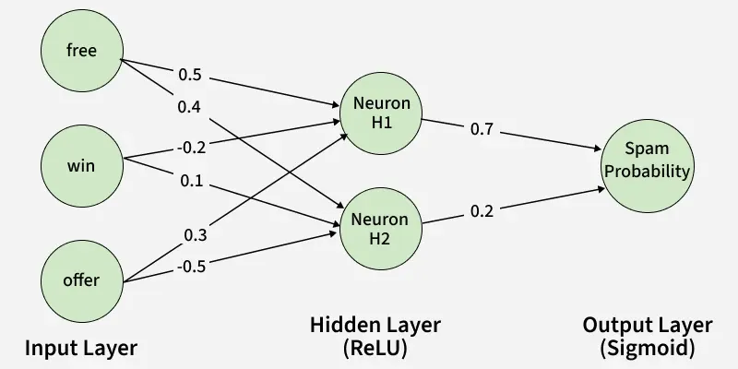

Slide 18
Learning of a Neural Network
1. Learning with Supervised Learning
In supervised learning, a neural network learns from labeled input-output pairs provided by a teacher. The network generates outputs based on inputs and by comparing these outputs to the known desired outputs, an error signal is created. The network iteratively adjusts its parameters to minimize errors until it reaches an acceptable performance level.
2. Learning with Unsupervised Learning
Unsupervised learning involves data without labeled output variables. The primary goal is to understand the underlying structure of the input data (X). Unlike supervised learning, there is no instructor to guide the process. Instead, the focus is on modeling data patterns and relationships, with techniques like clustering and association commonly used.

Slide 19
3. Learning with Reinforcement Learning
Reinforcement learning enables a neural network to learn through interaction with its environment. The network receives feedback in the form of rewards or penalties, guiding it to find an optimal policy or strategy that maximizes cumulative rewards over time. This approach is widely used in applications like gaming and decision-making

Slide 20
Implementation of Neural Network using TensorFlow
import numpy as np
import pandas as pd
from tensorflow.keras.models import Sequential
from tensorflow.keras.layers import Dense

Slide 21
Step 2: Create and Load Dataset
data = {
'feature1': [0.1, 0.2, 0.3, 0.4, 0.5],
'feature2': [0.5, 0.4, 0.3, 0.2, 0.1],
'label': [0, 0, 1, 1, 1]
}
df = pd.DataFrame(data)
X = df[['feature1', 'feature2']].values
y = df['label'].values

Slide 22
Step 3: Create a Neural Network
model = Sequential()
model.add(Dense(8, input_dim=2, activation='relu'))
model.add(Dense(1, activation='sigmoid'))

Slide 23
Step 4: Compiling the Model
model.compile(loss='binary_crossentropy',
optimizer='adam', metrics=['accuracy'])

Slide 24
Step 5: Train the Model
model.fit(X, y, epochs=100, batch_size=1, verbose=1)

Slide 25
Step 6: Make Predictions
test_data = np.array([[0.2, 0.4]])
prediction = model.predict(test_data)
predicted_label = (prediction > 0.5).astype(int)

Slide 26
Output:
Predicted label: 1

